Slide 1
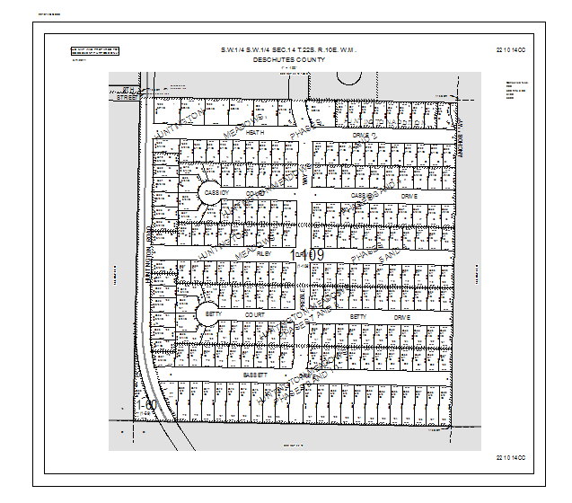
MapNumber
UpperRightMapNum
MainMapTitle
DisclaimerBox
CountyName
Disclaimer
MainMapScale
CanMapNumber
CanMapNumber2
PlotDate
CanMapNumber3
MainDF
LowerRightMapNum

Slide 2
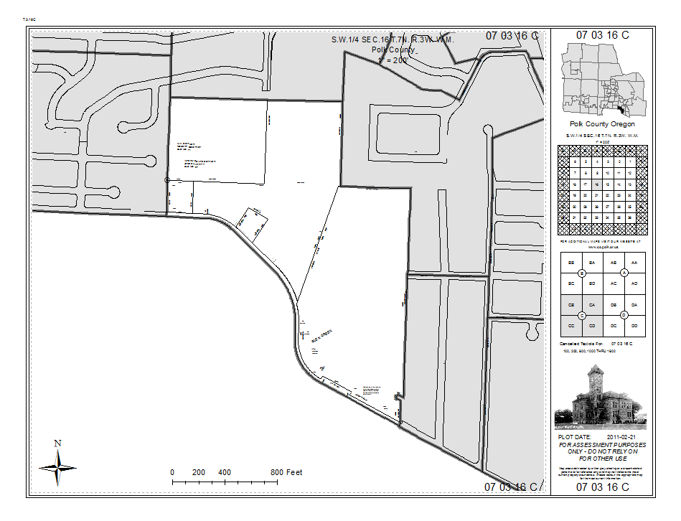
MapNumber
UpperLeftMapNum
UpperRightMapNum
MainMapTitle
CountyName
MainMapScale
LocatorDF
smallMapTitle
smallMapScale
SectionsDF
QSectionsDF
MainDF
PlotDate
Disclaimer
NorthArrow
ScaleBar
LowerLeftMapNum
LowerRightMapNum

